Slide 1
Impact of Local Interconnects and a Tree Growing Algorithm for Post-Grid Clock Distribution
Jiayi Xiao

Slide 2
Paper Titles

Slide 3
Impact of Interconnects on Timing in RLS/SDP Blocks
Local interconnects are believed to cause major impact on timing, power and routability in VLSI design
Interconnects generally affect the timing and power in the following ways
Wire delay
Cell delay degradation
Slope degradation
Delays due to the repeaters

Slide 4
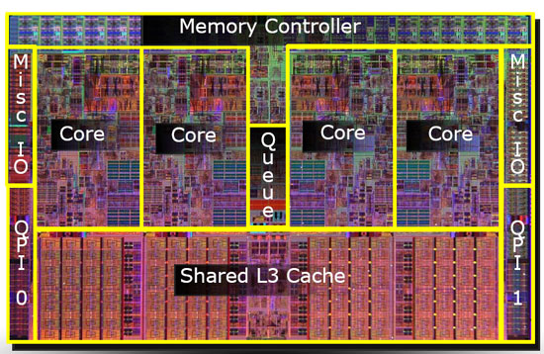
Simulation Environment
A 45nm IA processor (Nehalem)
86 RTL-to-layout synthesis (RLS) blocks
133 Semi-manually designed structured data
path(SDP) blocks
Focus on the impact of local (intra-block) interconnects
No consideration for intra-standard-cell wire delay (Poly and M1)
Source: http://www.anandtech.com/show/2658

Slide 5
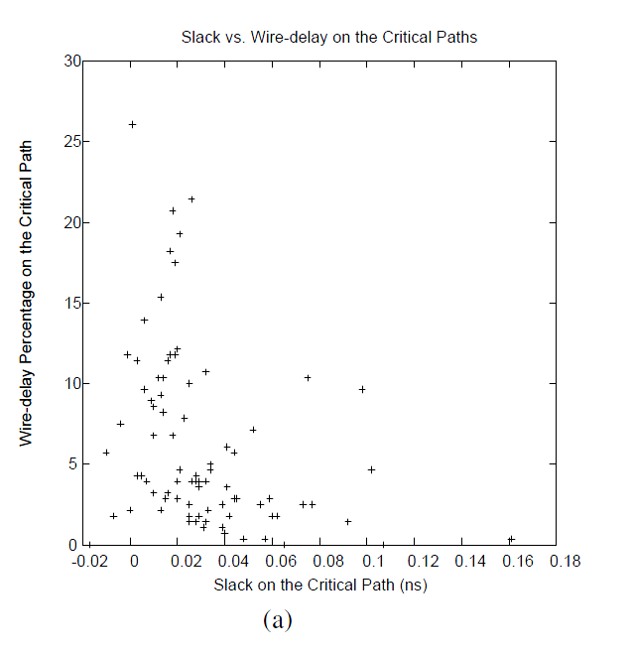
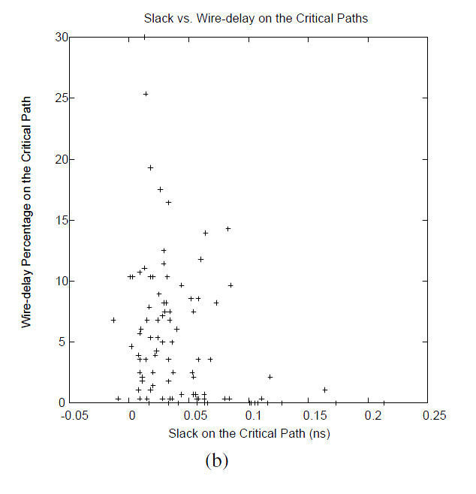
Wire Delay
The wire delay contributes to 6% and 5%, respectively, in RLS and SDP blocks
Figure 1: Wire-delay on the worst internal paths in (a) synthesized and in (b) semi-manually designed datapath blocks

Slide 6
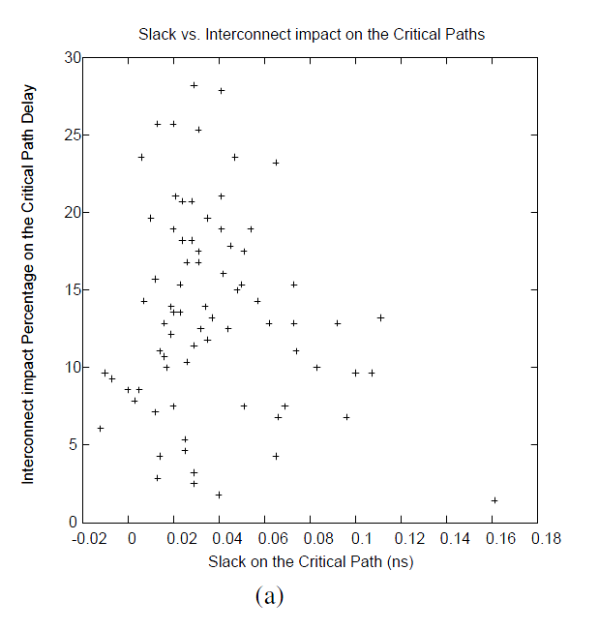
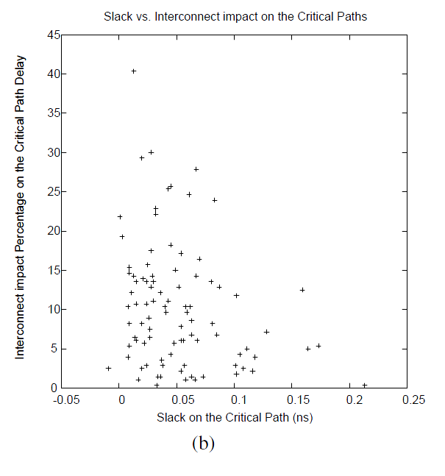
Cell Delay and Slope Degradation
Often known as secondary effects due to interconnects
Not secondary anymore in nanometer technology
It is 7% (13%) and 5% (9%) in both RLS and SDP blocks
Figure 2: Slack improvement percentage due to setting R and C of interconnects to 0 on the worst internal paths in (a) synthesized and in (b) semi-manually designed datapath blocks

Slide 7
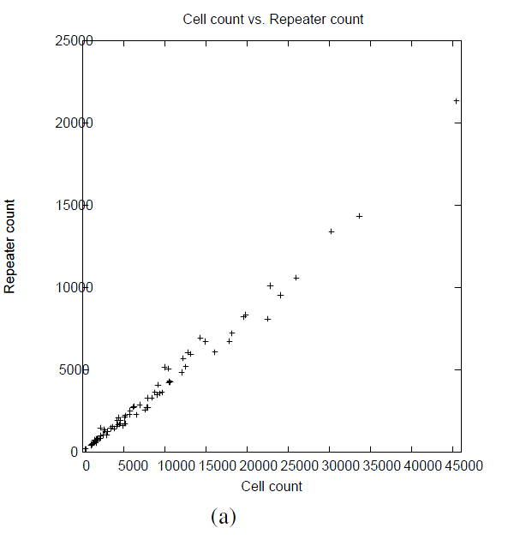
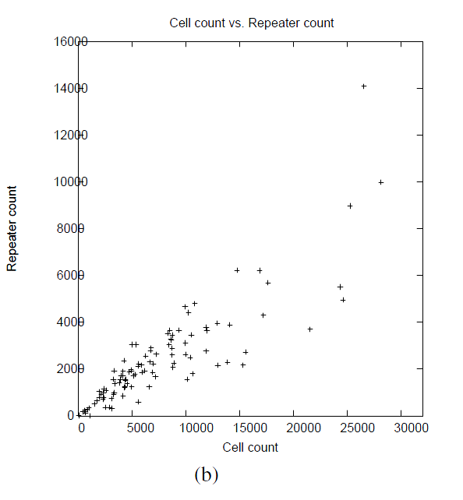
Repeater Count due to Interconnects
43% and 30% repeaters, respectively, in RLS and SDP blocks.
Figure 3: Number of repeaters vs. cell count in (a) synthesized and in (b) semi-manually designed datapath blocks

Slide 8
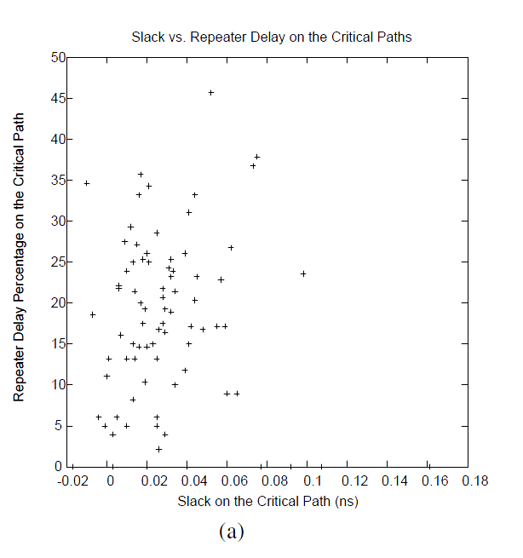
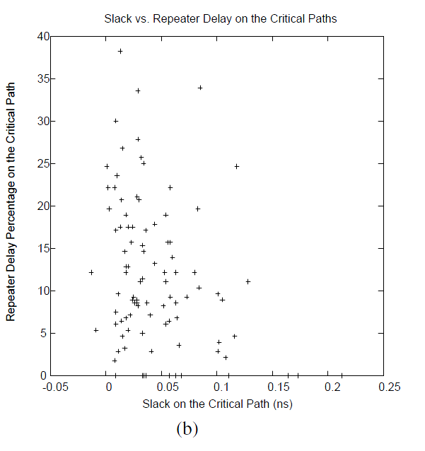
Overall Interconnect Delay Impact Including Repeater Delays
Wires contribute to 33% and 20% of the delay in RLS and SDP blocks
Repeaters contribute to 21% and 10%, respectively
Figure 4: Repeater delay percentage vs. slack on the worst critical paths in (a) synthesized and in (b) semi-manually designed datapath blocks

Slide 9
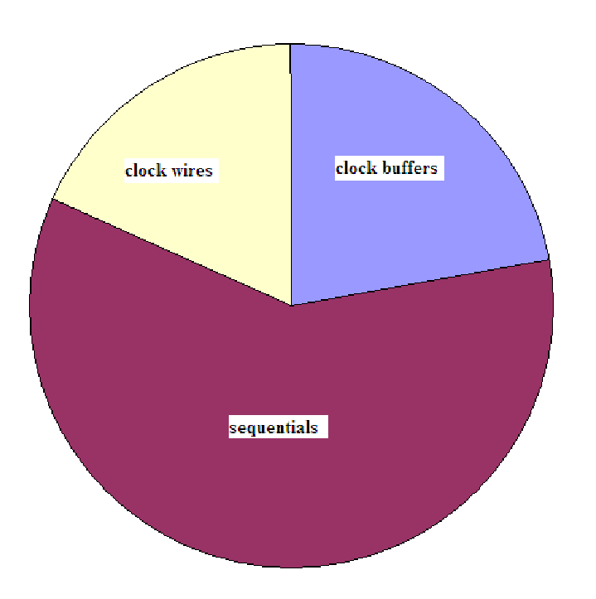
Power In Clock Interconnects and Buffers for RLS Blocks
The clock trees including sequentials contribute to 70% of total dynamic power
Only 20% of the cell count
Clock buffers and nets contribute 16% of the dynamic power
Only about 2% of the cell count
14%
16%
40%
Figure 5: Distribution of dynamic power in clock trees inside synthesized blocks

Slide 10
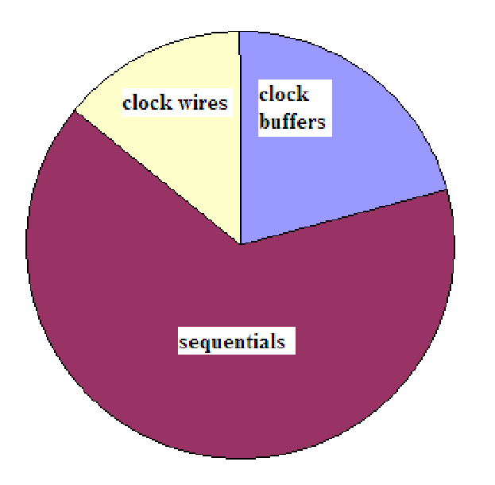
Power In Clock Interconnects and Buffers for SDP Blocks
The clock trees including sequentials contribute to 35% of total dynamic power
About 10% of the cell count
5%
6%
23%
Figure 6: Distribution of dynamic power in clock trees inside SDP blocks

Slide 11
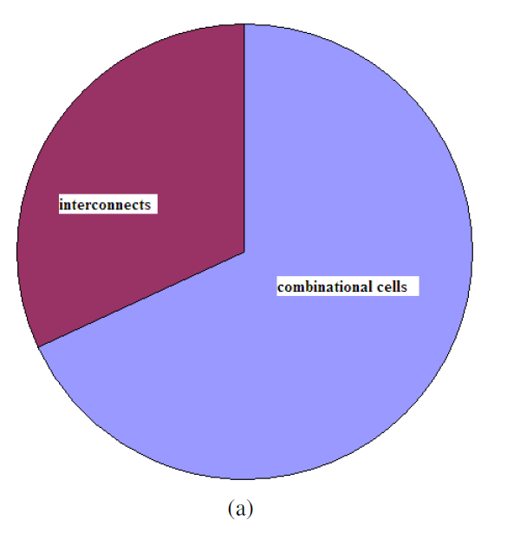
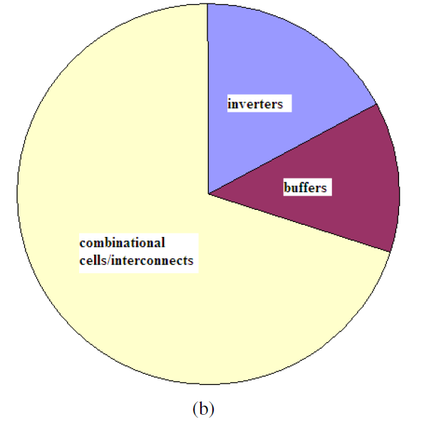
Impact to Dynamic Power in Combinational Logic for RLS Blocks
The combinational logic dissipates about 27% of the dynamic power
The repeaters (44% of cell count) constitute 30% of dynamic power
32%
30%
68%
70%
Figure 7: Distribution of dynamic power in combinational logic for synthesized blocks. (a) Distribution into combinational logic cells and interconnect. (b) Distribution of dynamic power in combinational logic cells into that in repeaters and other cells.

Slide 12
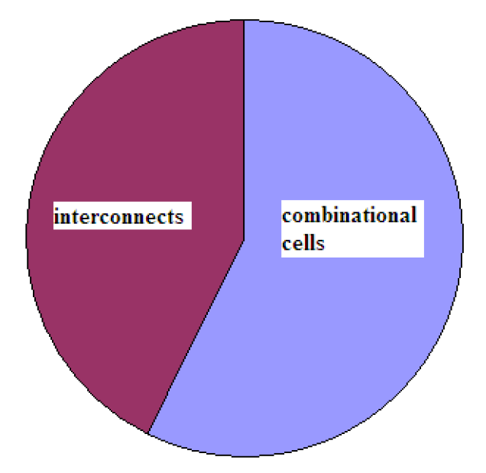
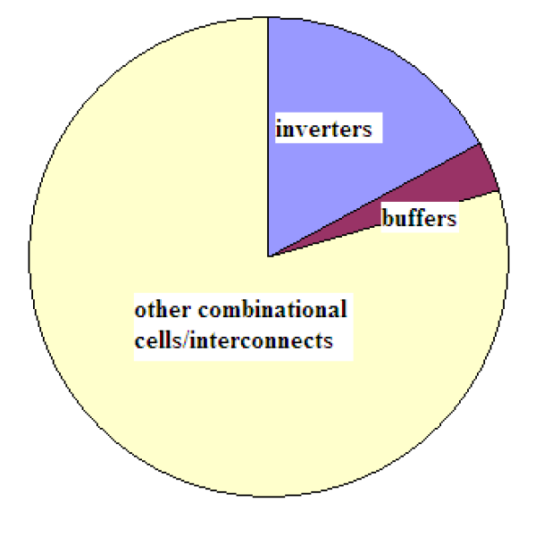
Impact to Dynamic Power in Combinational Logic for SDP Blocks
The combinational logic dissipates about 65% of the dynamic power
The repeaters (27% of cell count) constitute 20% of dynamic power
20%
47%
53%
80%
(a)
(b)
Figure 8: Distribution of dynamic power in combinational logic for SDP blocks. (a) Distribution into combinational logic cells and interconnect. (b) Distribution of dynamic power in combinational logic cells into that in repeaters and other cells.

Slide 13
Conclusion
Local interconnects contribute to more that 1/3 of the delay in RLS blocks and about 1/5 in SDP blocks
RLS blocks have 13% more repeater than SDP blocks
Some secondary effects are not second order
Local interconnects contribute 27% and 35% to the dynamic power in RLS and SDP blocks
The percentage is even higher in clock trees
Power dissipation due to clock interconnects and buffers is a big problem

Slide 14
Routing With Constraints for Post-Grid Clock Distribution

Slide 15
Routing With Constraints for Post-Grid Clock Distribution
In high-performance microprocessors, clocks are distributed employing hybrid networks, containing global grid followed by buffered gated trees
Figure 9: (a) Global clock distribution to layout areas employing spines for grid. (b) Clock distribution from grid wires to sequentials in a block inside layout area

Slide 16
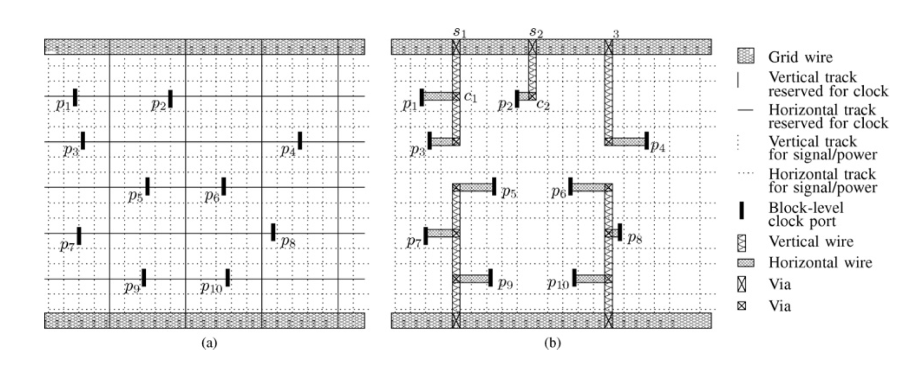
Routing With Constraints for Post-Grid Clock Distribution
Clock routing from global grid to buffered gated local clock tree is known as post-grid clock distribution
Traditionally, this routing is carried out manually
Often employing the nearest source heuristic and up-sizing strategy
Very time-consuming and non-optimal
Figure 10: Global clock routing topology, with horizontal grid wires and tracks for routing in both directions. (b) Routing solution.

Slide 17
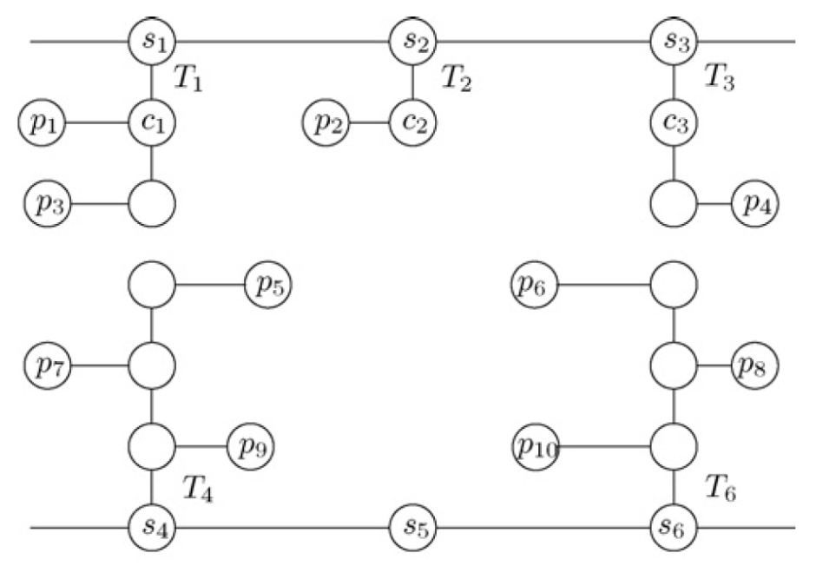
Problem Formulation
A routing graph with three type nodes
Port-nodes($P_{i}$), Via nodes($C_{j}$) and Source-nodes ($S_{k}$)
Constructing a set of trees, $T_{i}$ so that minimizing $\sum_{∀T_{i}}{(\sum_{∀e∈T_{i}}{w\left(e\right)})}$, where
$delay\left(s_{i},p_{i}\right)≤delay_{limit}∀P_{i}∈T_{i}$
$\sum_{∀P_{i}}{slope(p_{j})}≤slope_{limit}$

Slide 18
Tree Growing Algorithm

Slide 19
Tree Growing Algorithm, Continued

Slide 20
Tree Growing Algorithm, Continued

Slide 21
Tree Growing Algorithm, Continued

Slide 22
Tree Growing Algorithm, Continued
Figure 12: Comparison between (b) the nearest source heuristic and (c) tree-growing algorithm

Slide 23
Algorithm Complexity and Delay Model
The time complexity of the algorithm is $O\left({\left|E\right|}^{2}\log\left|E\right|\right),$ where $\left|E\right|=O\left(n+l+m\right);n, l, m$ are the numbers of port nodes, candidate via nodes and source nodes
The delay checking employs elmore delay model, while the skew is calculated by $\sqrt{{\left(2.2RC\right)}^{2}+{\left(S_{I}\right)}^{2}},$ where $S_{I}$ is the slope of the waveform at the input of the segment

Slide 24
Simulation Results

Slide 25
Conclusion
Massive total wire length reduction
14% wire length improvement compared to the nearest source heuristic
Great speed improvement
Routing thousands of terminals over $mm^{2}$ area in seconds

Slide 26
References
[1] R. S. Shelar, “Routing With Constraints for Post-Grid Clock Distribution in Microprocessors,” IEEE Trans. Comput.-Aided Design Integr. Circuits Syst., vol 29, no. 2, pp.245-249, Feb. 2010.
[2] R. S. Shelar and M. Patyra, “Impact of Local Interconnects on Timing and Power in a High Performance Microprocessor,” in Proc. Int. Symp. Physical Design (ISPD), Mar. 2010, pp. 145-152.
[3] R. Kumar and G. Hinton. “A family of 45nm IA processors,” in International Solid-State Circuits Conference, pages 58–59, February 2009.

