Slide 1
EECS 527 Paper Presentation
Accurate Estimation of Global Buffer Delay
Within a Floorplan
- by Charles J. Alpert, Jiang Hu, Sachin S. Sapatnekar, C.N.Sze
Presented by Yuan Zong
Department Electrical Engineering and Computer Science
University of Michigan, Ann Arbor
04/2013

Slide 2
EECS 527 Paper Presentation
Outlines
Introduction
Closed-form Formula for Two-Pin Nets
Delay Formula with No Blockages
Delay Formula with Blockages
Two-Pin Experiment
Linear-Time Estimation for Trees
Unblocked Steiner Points
Blocked Steiner Points
Algorithm
Experiments for Multisink Nets
Q & A

Slide 3
Introduction
Closed-form expression for buffered interconnect delay
Buffer insertion is a critical component of physical synthesis
Previous approaches assume buffers are free to place any where
Blockages are now first-order delay effect
But None of the studies address the problem of delay estimation

Slide 4
Introduction
Development on this paper
Extension of Otten’s theory
Predicting interconnect delays for multifanout nets in presence of blockages and validation
A fast and simple formula is proven in real design scenarios and can be practical used in early floorplaning
Application
Access timing cost of different block configurations during floorplanning
Access different Steiner routes during wire planning
Embed the formula into a placement algorithm
Notes:
Otten theory: show how one can model the blocks into a simple delay-estimation technique that applies to both two-pin and multipin nets

Slide 5
Introduction
Key assumption in this approach
Smaller blocks ignored
Single-buffer type
Block location is ignored
Infinitesimal decoupling buffers
Larger block front-to-end buffering
Optimally buffered line with equally spaced buffers
Optimal realizable buffering when blockages are present
Notes:
Otten theory: show how one can model the blocks into a simple delay-estimation technique that applies to both two-pin and multipin nets
L-> L opt spacing btw two buffers that obtain optimal signal propagation speed. We can ignore blocks smaller than L opt. (b) is optimal realizable buffering when blockage present. As long as the blocks are smaller than Lopt, the optimal realizable buffering (b) will have a delay very close to the ideal buffering of (a).-> can assume the delay model of (a) is approximate (b).
(3) Blocks closer to source or sink has little effect on actual buffered delay.
(4) Buffers for decoupling the capacitance off the critical path can be modeled to have zero input capacitance. -> underestimation, but negligible
(5) For blocks larger than Lopt, place buffer before and after the block to assure optimal buffering.

Slide 6
Closed-form Formula for Two-Pin Nets
Basic assumption and idea
Assume an “ideal” buffer/inverter b that is optimal for signal propagation
Intrinsic Resistance: $R_{b}$Input Capacitance: $C_{b}$
Unit wire resistance and capacitance: R, C
Assumption:
Driver of net has the same drive resistance as b
Sink of the net has an input capacitance of $C_{b}$
Intrinsic buffer delay is zero
$τ_{gate}$ = $R_{b}∗(C∗L_{opt}+C_{b}$)
$τ_{wire}$ = $R∗L_{opt}∗(0.5C∗L_{opt}+C_{b})$

Slide 7
Closed-form Formula for Two-Pin Nets
Delay Formula with No Blockages
Theorem 1: The delay D(L) function of an optimally buffered line of length L with no blockages is the linear function of the design and buffer parasitic given by
$D\left(L\right)=L\left(R_{b}C+RC_{b}+\sqrt{2R_{b}C_{b}RC}\right)$ (1)
Proof: Let k be number of stages (k-1 buffers) that result in the optimal delay along L. The length of wire between consecutive stages is L/k. The delay on the line is given by k times sum of buffer delay and wire delay
$D\left(L\right)=k\left(R_{b}(\frac{CL}{k}+C_{b})+\frac{RL}{k}(\frac{CL}{2k}+C_{b})\right)$ (2)
By taking derivative with respect to k, setting expression to zero:
$k=L\sqrt{\frac{RC}{2R_{b}C_{b}}}$ (3)

Slide 8
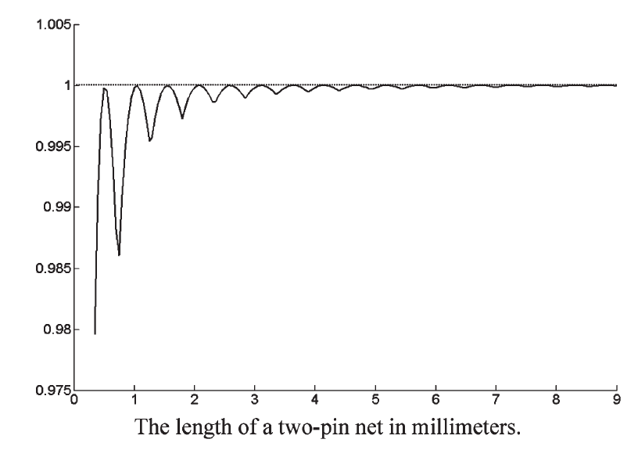
Closed-form Formula for Two-Pin Nets
Delay Formula with No Blockages
Theorem 1 is independent of number of buffers.
Though D(L) in Equation 1 is a lower bound of realizable delay, the error is small
As L goes to infinity, the ratio becomes one
Maximum error occurs when k is not an integer
Corollary 1: The optimum spacing $L_{opt}$ between buffers is:
$L_{opt}= \sqrt{\frac{2R_{b}C_{b}}{RC}}$ (4)
Ratio of (1) to (2)

Slide 9
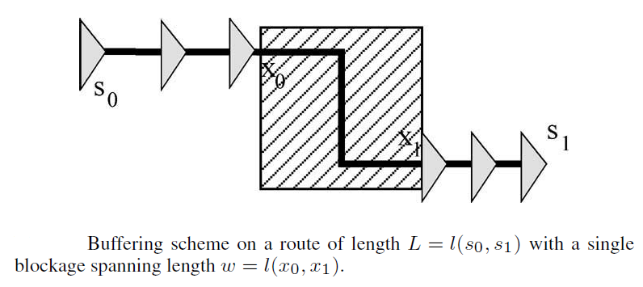
Closed-form Formula for Two-Pin Nets
Delay Formula with Blockages
Consider inserting a block of width w somewhere on the line L
Let l(u,v) be the length of route from u to v
Two cases:
w < $L_{opt}$
Ignore w and just use Theorem 1
w > $L_{opt}$
Placing a buffer before and after a blockage
For the reset of line, use Theorem 1

Slide 10
Closed-form Formula for Two-Pin Nets
Delay Formula with Blockages
For w > $L_{opt}$, buffered delay is the sum of buffered delay of unblocked wires and delay needed to cross the blockage:
$ED\left(w\right)=R_{b}\left(C_{w}+C_{b}\right)+R_{w}(\frac{C_{w}}{2}+C_{b})$ (5)
Given a set of blockages W with w > $L_{opt}$, we overload the D function in Equation 1 and ED function in Equation 5, then Blockage Buffered-Delay formula is :
$D\left(L,W\right)=D\left(L−L_{w}\right)+\sum_{wεW}{ED\left(w\right), where L_{w}=\sum_{wεW}{w}}$ (6)
It could conceivably overestimate delay, but the delay from an optimal solution is rarely smaller than it

Slide 11
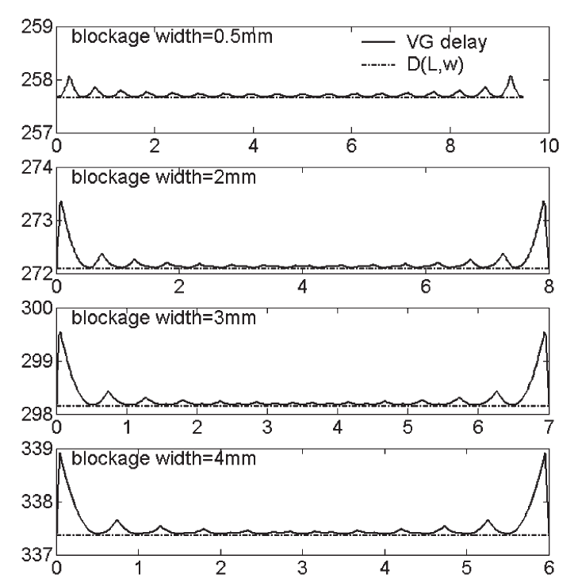
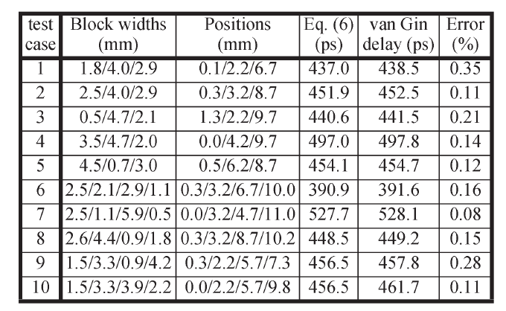
Two-Pin Experiment
Comparing formula D(L,W) with the optimal delay
A single blockage
100 nm technique
10-mm wire
Error is less than 1%
Maximum error occurs at tail end
Multiple blockages
Different scenarios
12-mm wire
Error is less than 1%
A single blockage
Multiple blockages
Notes:
Maximum error occurs at tail end, because this is where one may have to either inset 2 buffers that are too close together; or drive a distance that is longer than blockage.

Slide 12
Linear-Time Estimation for Trees
Key Ideas:
Two convenient properties of the estimation techniques
Can be decomposed into a summation of piecewise components
Delay can be broken into sum of delays on a given path
T(V,E) be a Steiner tree with a source node $s_{0}$ and sinks $s_{1},…,s_{n}$
RAT($s_{i}$) be the required arrival time for sink $s_{i}$
→ quality of a buffer solution is:
$q\left(s_{0}\right)=\min_{1≪i≪n}\{RAT\left(s_{i}\right)−Delay(s_{0},s_{i})\}$ (7)
Assumption:
All subtrees off the critical path will be decoupled
Decoupling buffer should have minimum possible input capacitance, assuming to be zero

Slide 13
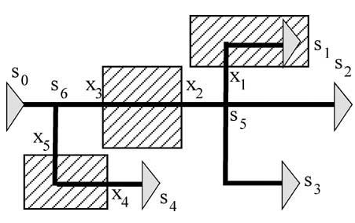
Linear-Time Estimation for Trees
Unblocked Steiner Points
All decoupling of branches can be accomplished by placing the buffer near Steiner point
Delay can be broken piecewise into sum of its subpaths
$Delay\left(s_{0},s_{1}\right)=D\left(l\left(s_{0},s_{1}\right),\left\{l\left(x_{3},x_{2}\right),l\left(x_{1},s_{1}\right)\right\}\right)$ (8)
$Delay\left(s_{0},s_{2}\right)=D\left(l\left(s_{0},s_{2}\right),\left\{l\left(x_{3},x_{2}\right)\right\}\right)$
$Delay\left(s_{0},s_{3}\right)=D\left(l\left(s_{0},s_{3}\right),\left\{l\left(x_{3},x_{2}\right)\right\}\right)$
$Delay\left(s_{0},s_{4}\right)=D\left(l\left(s_{0},s_{4}\right),\left\{l\left(x_{5},x_{4}\right)\right\}\right)$
where D(L,W) is given by Equation 6

Slide 14
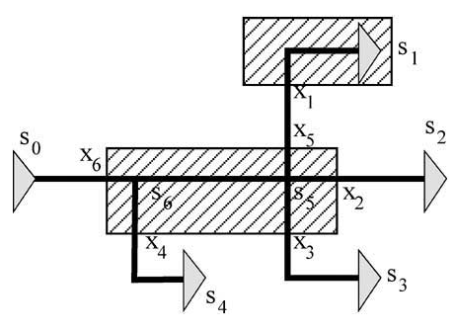
Linear-Time Estimation for Trees
Blocked Steiner Points
Decoupling may only occur outside the blockage
Track the off-path capacitance and multiply it by upstream resistance
Add the delay from extra capacitance loading on driving buffer
$OD(l_{r},l_{c})$ represents delay from the off-path capacitance inside a blockage:
$OD\left(l_{r},l_{c}\right)=(R∗l_{r}+R_{b})(C∗l_{c})$ (9)
$Delay\left(s_{0},s_{1}\right)=D\left(l\left(s_{0},s_{1}\right),\left\{l\left(x_{6},x_{5}\right),l\left(x_{1},s_{1}\right)\right\}\right)$
$+OD\left(l\left(x_{6},x_{5}\right),l\left(x_{5},x_{2}\right)+l\left(s_{5},x_{3}\right)\right)$
$+OD\left(l\left(x_{6},s_{6}\right),l\left(s_{6},x_{4}\right)\right)$
$Delay\left(s_{0},s_{1}\right)=D\left(l\left(s_{0},s_{4}\right),\left\{l\left(x_{6},x_{4}\right)\right\}\right)$
$+OD\left(l\left(x_{6},x_{6}\right),l\left(s_{6},x_{5}\right)+l\left(s_{5},x_{2}\right)+l(s_{5},x_{3})\right)$
(10)
Notes:
Since we need to insert buffer before and after blockages, we need to consider the delay of the input buffer as the delay of the blockages. R=Rb+R*lr. C=off-path cap

Slide 15
Linear-Time Estimation for Trees
Linear-time Estimation Algorithm
Can use Equation 10 and Equation 8 to find delay to any sink
But how to compute the slack at source without computing each individual sink
A linear-time algorithm to compute the slack at source
Bottom-up tree traversal
Edges in the tree are segmented
Let C(v) represent subtree capacitance downstream from v
$C\left(s_{5}\right)=C\left(l\left(s_{5},x_{3}\right)+l\left(s_{5},x_{5}\right)+l\left(s_{5},x_{2}\right)\right)$
$C\left(s_{6}\right)=C\left(s_{5}\right)+C∗\left(l\left(s_{6},x_{4}\right)+l\left(s_{6},x_{5}\right)\right)$
(11)
Notes:
We assume that the edges in the tree are segmented such that, whenever a blockage in W intersects a tree edge, the edge is broken into two edges incident to an intermediate boundary node (as the xis
are in Figs. 5 and 6). Therefore, each edge (u, v) lies either completely inside or outside a blockage in W. Boundary nodes lie outside W. A node lies inside W only if it is completely inside a blocking W (e.g.,
in Fig. 6 only s5 and s6 lie inside W).

Slide 16
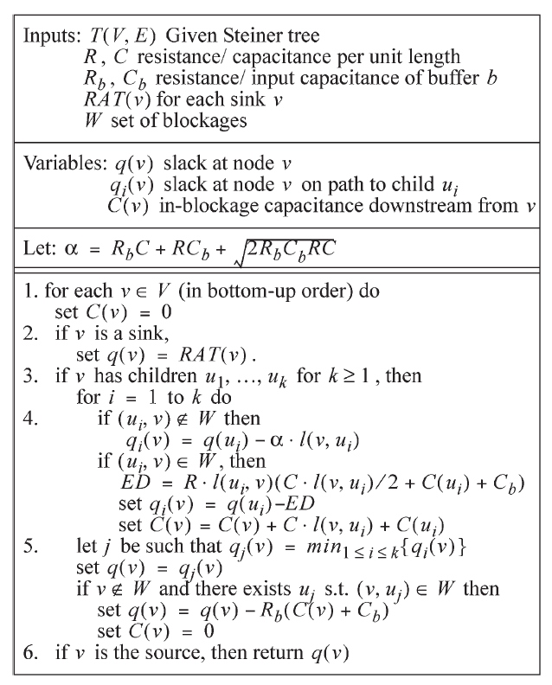
Linear-Time Estimation for Trees
Linear-time Estimation Algorithm
1: visits and initializes all nodes
2: handles cases where v is sink
3: handles multiple children
4: updates upstream information
5: identifies the child $u_{i}$ of $v$
6: returns the slack at the source
Notes:
We assume that the edges in the tree are segmented such that, whenever a blockage in W intersects a tree edge, the edge is broken into two edges incident to an intermediate boundary node (as the xis
are in Figs. 5 and 6). Therefore, each edge (u, v) lies either completely inside or outside a blockage in W. Boundary nodes lie outside W. A node lies inside W only if it is completely inside a blocking W (e.g.,
in Fig. 6 only s5 and s6 lie inside W).

Slide 17
Experiments for Multisink Nets
Comparing 4 buffered slack calculation
Blockage estimation in linear time (BELT): this approach
Estimation in linear time (ELT): estimation formula while ignoring blockages
VG1: van Ginneken’s algorithm using the single-buffer type b
VG4: van Ginneken’s algorithm using the four types of buffer (b is the largest)

Slide 18
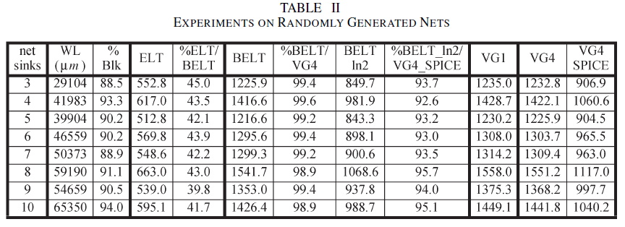
Experiments for Multisink Nets
Results on Random Nets
Comparing ELT and BELT in column 5: errors are off by over a factor of two if ignores the blockage
Comparing BELT and VG1: underestimate by 1.1% on the average
Comparing BELT and VG4: underestimate by 0.8% on the average

Slide 19
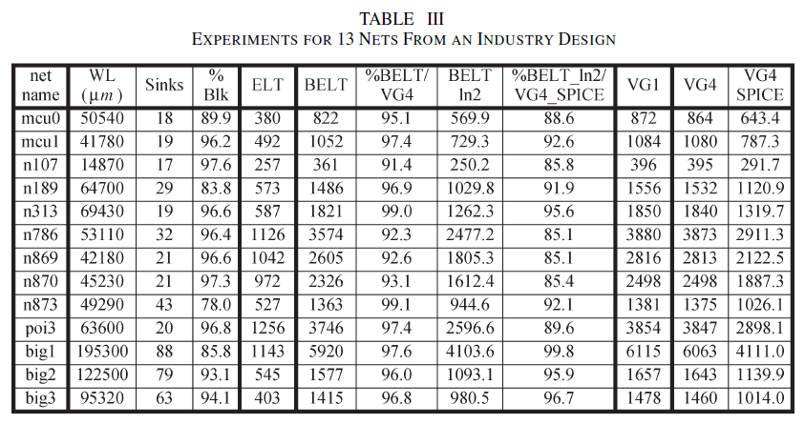
Experiments for Multisink Nets
Results on Large Real Nets
On average, ELT/BELT is 36.2%, which means blockage has a 64% impact on the average for these nets
Impact of blockage differs: net 107 and netbig1
On the average, error of BELT compared to VG4 is 5.2%

Slide 20
EECS 527 Paper Presentation
Reference
C. J. Alpert , J. Hu , S. S. Sapatnekar and C. N. Sze "Accurate estimation of global buffer delay within a floorplan", Proc. IEEE/ACM Int. Conf. Comput.-Aided Des., pp.706 -711 2004
R. H. J. M. Otten, "Global Wires Harmful?", ACM/IEEE Intl. Symposium on Physical Design, pp. 104-109, 1998

Slide 21
EECS 527 Paper Presentation
Thanks!
Q & A

